Slide 1

🎯 Scrum-Agile Roles
Key Roles in a Scrum-Agile Team
Product Owner: Defines the product vision, prioritizes backlog items, and ensures value delivery to stakeholders.
Scrum Master: Facilitates Scrum events, removes blockers, and coaches the team on Agile principles.
Development Team: Cross-functional members who self-organize to deliver increments of working software.
🧠 Each role is essential for maintaining transparency, collaboration, and continuous improvement.

Slide 2
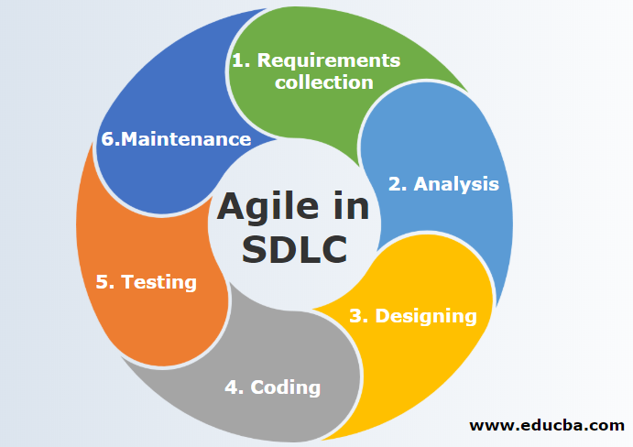
🔄 Agile SDLC Phases
Phases of the Agile Software Development Life Cycle
Requirement Gathering: Stakeholder collaboration to define user stories.
Design: Translate requirements into wireframes or prototypes.
Development: Iterative coding in short sprints.
Testing: Continuous integration and user acceptance testing.
Deployment: Frequent releases using automated tools.
Feedback: Stakeholder input drives refinement and future planning.
📌 Agile emphasizes adaptability and customer-centric development.

Slide 3
🔁 Waterfall vs. Agile Comparison
Waterfall vs. Agile Development Approaches
📊 Source: ProductPlan Comparison
Feature | Waterfall | Agile
Structure | Linear, sequential | Iterative, incremental
Flexibility | Low | High
Feedback | End of project | Continuous
Risk Management | Late detection | Early detection
Best For | Fixed-scope projects | Evolving requirements

Slide 4

⚖️ Choosing the Right Approach
Factors for Selecting Waterfall or Agile
Project Scope: Fixed scope favors Waterfall; evolving scope suits Agile.
Client Involvement: Agile thrives on frequent feedback; Waterfall limits interaction.
Timeline & Budget: Waterfall offers predictability; Agile allows flexibility.
Team Dynamics: Agile supports self-organizing teams; Waterfall relies on structured roles7.
🧠 For SNHU Travel, Agile was ideal due to changing requirements and the need for rapid iteration.

Slide 5
📚 References
ProductPlan. (2025). Agile vs. Waterfall: Pros, Cons, and Key Differences. https://www.productplan.com/learn/agile-vs-waterfall/
Coursera. (2025). Scrum Roles and Responsibilities Explained. https://www.coursera.org/articles/scrum-roles-and-responsibilities
GeeksforGeeks. (2025). Agile SDLC (Software Development Life Cycle). https://www.geeksforgeeks.org/software-engineering/agile-sdlc-software-development-life-cycle/
SixSigma.us. . (2025). What is Agile SDLC? A Complete Overview. https://www.6sigma.us/six-sigma-in-focus/agile-sdlc-software-development-life-cycle/
Scrum Alliance. (2025). The Scrum Team Roles and Accountabilities. https://resources.scrumalliance.org/Article/scrum-team
ONES.com. . (2025). Choosing Between Waterfall and Agile in 2025. https://ones.com/blog/comparison/choosing-waterfall-agile-key-factors-use-cases/

